Slide 1
Library Management system
- Ramesha

Slide 2
Problem Statement:
As we can observe that the ancient method of Library Management System is much difficult to track each and every transactions which take place in the library .
Like:-
Number of Books in the library.
Student details.
Student’s who are all barrowing the books.
Date of issuing the book and return date.
All these are handled manually by the authorities and they faced a challenges to maintain the system accordingly.

Slide 3
Solutions we came up with:
To overcome the problems which are stated above, we came up with a project Library Management System which connects the each module.
It is a intranet based application that can accessed throughout the campus.
This system can be used to search for books, request, and issue/return the books from library and it can be used by both librarian and the students.

Slide 4
Tools and Technologies:
Software Requirements:
Windows 10
Postman
My sqlyog
Eclipse-JDK 1.8
Visual Studio
Technology used:
Spring Rest
Angular 8

Slide 5
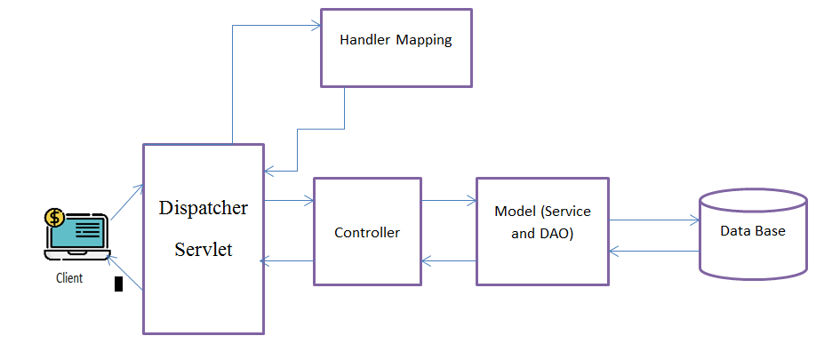
Spring Rest Architecture:

Slide 6
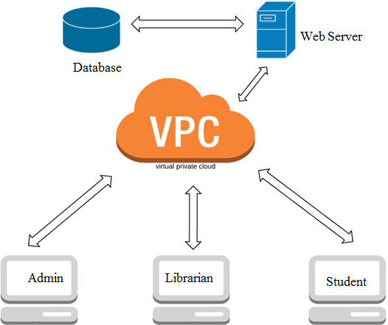
System Architecture:

Slide 7
Modules We are Using:
Admin :- He can add the user, remove the user and in case of any changes has to be done to the user, he can update those changes and finally he can see all the users of library.
Librarian :-He can add or remove and update the books. With that he can also accept the book which has been requested by the student and issue the book if it is available in the library.
Student :- His role is to search for the book in the library and request for the book.

Slide 8
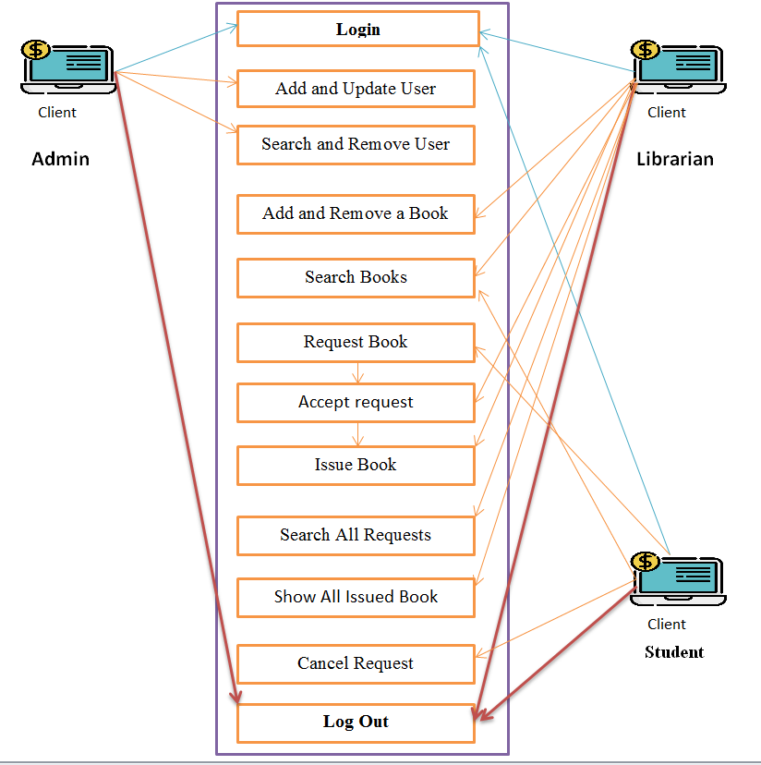
Use Case Diagram:

Slide 9
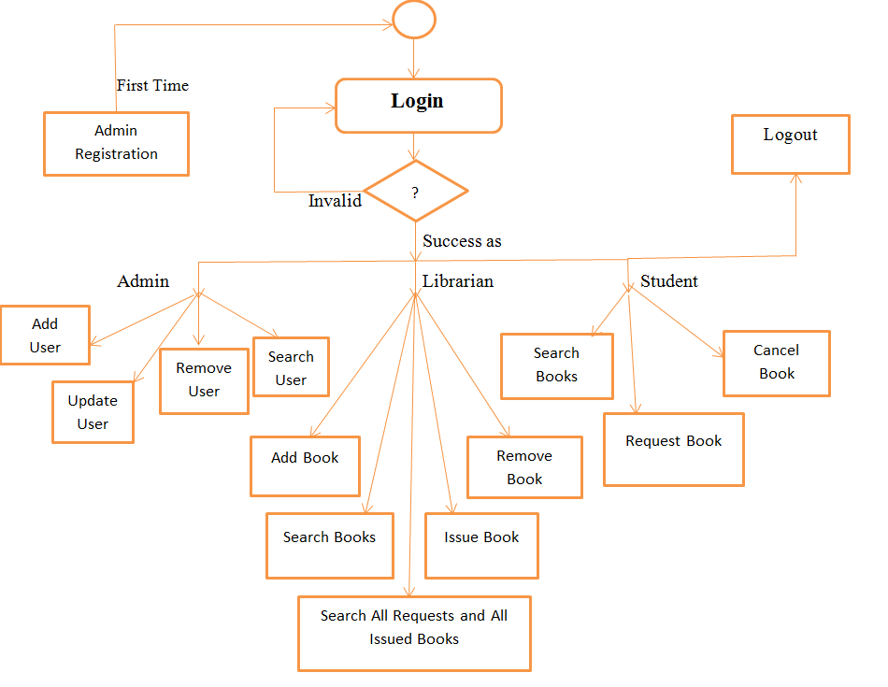
Flow Chart:

Slide 10
Conclusion:
This website provides a computerized version of library management system which will benefits the students as well as the staff of the library.
It makes entire process online where student can search books, staff can generate reports and do book transactions. It also has a facility for student to login and can see all books and he will request for a book and cancel a book Request.

